Slide 1
Dynamics 365 For Finance & Operations: Local Business Data (On-Premise Deployments)

Slide 2
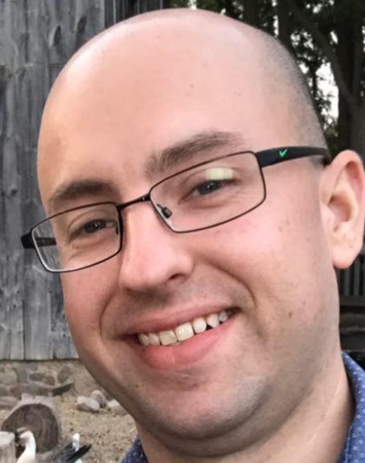
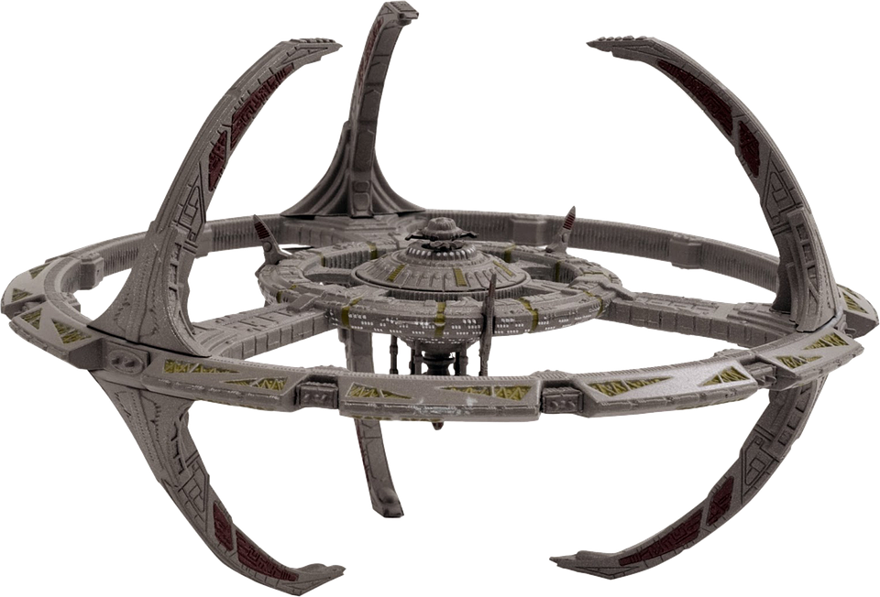


Speaker Blog
Nathan Clouse
Technical Solution Architect
MCA Connect, LLC
AXUG Summit Track Leader 2018/19
Nathan.clouse@mcaconnect.com
www.atomicax.com
@NathanClouseAX
Notes:
What base is this?

Slide 3
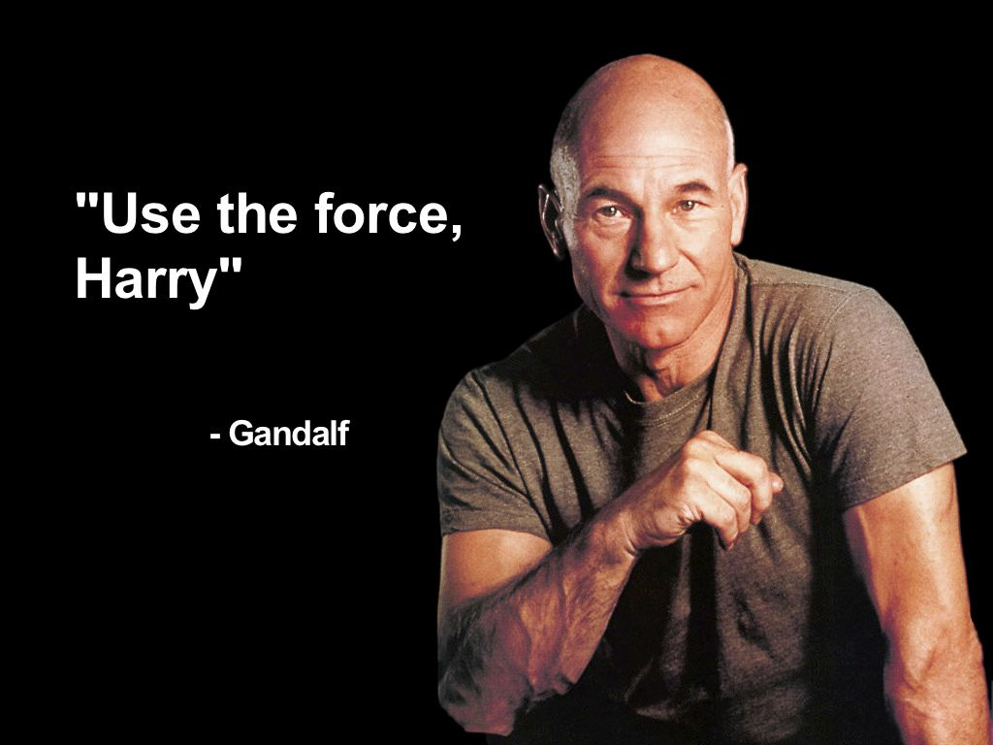

Slide 4

Getting Started - Topics
Requirements
Planning
Pre-execution
Execution
Deployment
Notes:
https://docs.microsoft.com/en-us/dynamics365/unified-operations/dev-itpro/deployment/plan-onprem-deployment

Slide 5

But First – Known Issues!
https://docs.microsoft.com/en-us/dynamics365/unified-operations/dev-itpro/deployment/setup-deploy-on-premises-pu12#known-issues
Notes:
Check out known issues before you start, while working and after you are done
https://docs.microsoft.com/en-us/dynamics365/unified-operations/dev-itpro/deployment/setup-deploy-on-premises-pu12#known-issues

Slide 6
Requirements

Slide 7
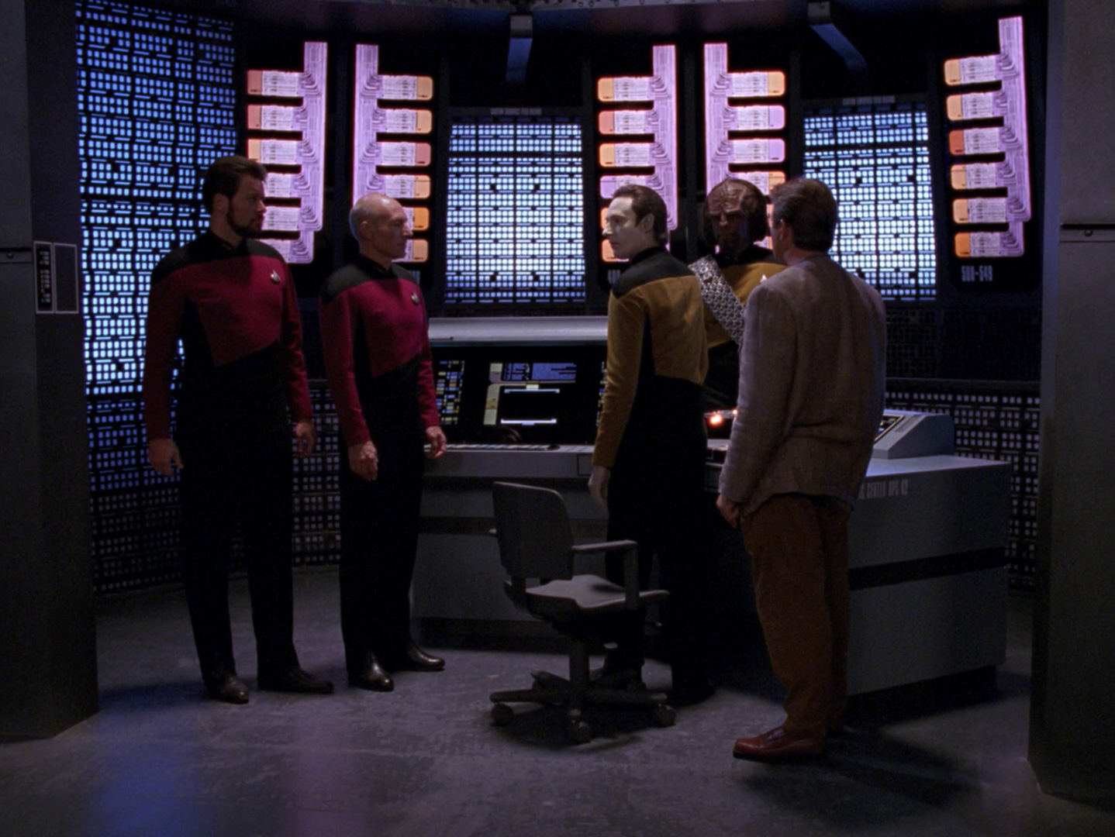
Infrastructure
Can’t Be In Cloud (Azure, AWS, Private external)
Must be in same physical data center
deployment packages are downloaded from LCS
More control with recent LBD Agents
Notes:
Only supported on your hardware
Same data center meaning 1 room – no uplinks to other hardware sets
LCS pushes out ~1 gig deployment packages; can be staged with local agent 2.1
https://docs.microsoft.com/en-us/dynamics365/unified-operations/dev-itpro/deployment/setup-deploy-on-premises-pu12#infrastructure

Slide 8
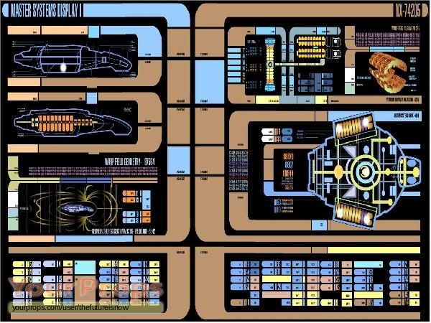
Infrastructure
Lots of Hardware
A single 5 node cluster, depending on duty, can take 48 gigs of RAM and 16 vCPUs at a minimum
RAM: AOS, 16; Orch, 8; Orch, 8; SSRS, 8; MR, 8; (48)
vCPU: AOS, 8; Orch, 2; Orch, 2; SSRS, 2; MR, 2; (16)
Notes:
What starship info is in the screenshot?

Slide 9
Infrastructure
Lots of VMs
Each cluster is at a minimum 5 VMs (nodes) and you will have multiple clusters. MS suggests 7 (min) nodes per cluster but recommends 8
Non-production: 3 clusters * 7 nodes = 21 VMs + 3 (SQL, FS, ADFS [minimum]) = 24 VMs
Production: 1 cluster * 8 nodes = 8 + 3 (SQL, FS, ADFS [minimum]) = 11 VMs
35

Slide 10
Prerequisites

Slide 11

Components
SNAC – ODBC driver 13 and 17
SQL Server Management Studio 17.9 (not 18)
Microsoft Visual C++ Redistributable Packages for Microsoft Visual Studio 2013, 2015, 2017
Microsoft Access Database Engine 2010 Redistributable
.NET Framework version 4.0–4.8 (CLR 4.0)
Notes:
https://docs.microsoft.com/en-us/dynamics365/unified-operations/dev-itpro/deployment/setup-deploy-on-premises-pu12#finance-and-operations-components

Slide 12

Components
All Others Packaged with Windows 2016
Domain Controller must be 2012 R2 or later (Domain Functional Level 2012 R2+ )
AAD*
Notes:
Installing SSMS takes a while, just put template. If not needed, its just wastes a little disk space
https://docs.microsoft.com/en-us/dynamics365/unified-operations/dev-itpro/deployment/setup-deploy-on-premises-pu12#finance-and-operations-components

Slide 13
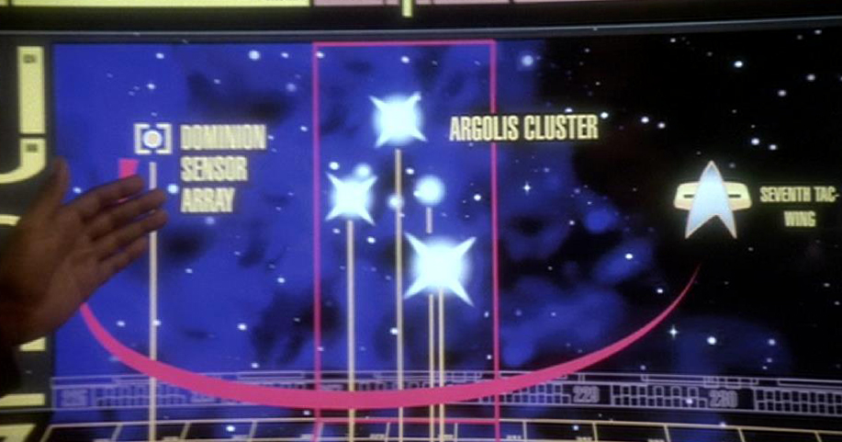
VMs - Cluster
Windows 2016 Template (For All Cluster Nodes)
With SQL Server Management Studio (SSMS) already installed
Already on Domain
Notes:
https://docs.microsoft.com/en-us/dynamics365/unified-operations/dev-itpro/deployment/setup-deploy-on-premises-pu12#finance-and-operations-components

Slide 14

VMs - Cluster
Install Azure PowerShell Extensions
Download Local Agent from LCS
Disable UAC Manually
Restart
Notes:
Installing SSMS takes a while, just put template. If not needed, its just wastes a little disk space
https://docs.microsoft.com/en-us/dynamics365/unified-operations/dev-itpro/deployment/setup-deploy-on-premises-pu12#finance-and-operations-components
What star system is this?

Slide 15
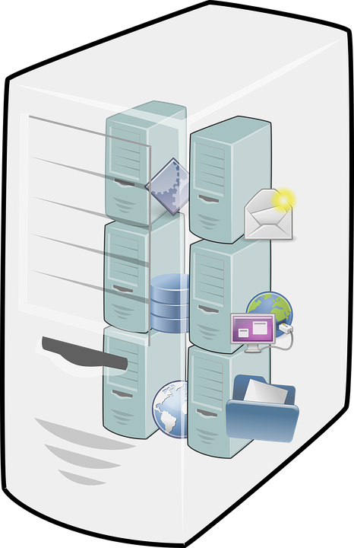
VMs – Non-Cluster
SQL Server 2016 SP2
Fileserver on Windows 2016 (SMB 3.0+)
ADFS (can be shared or per instance)
Notes:
Windows 2016 for everything basically
ADSF has to be 2012 R2 or newer
ADFS – can share, don’t suggest; scripts only work on first install for ADFS
https://docs.microsoft.com/en-us/dynamics365/unified-operations/dev-itpro/deployment/setup-deploy-on-premises-pu12#finance-and-operations-components

Slide 16
Planning

Slide 17
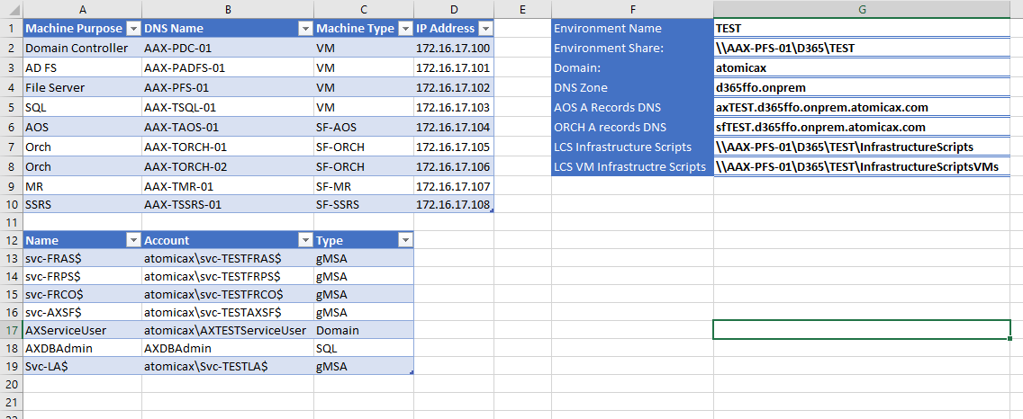
Shameless Self Promotion!
https://github.com/NathanClouseAX/LBDDeploymentHelper
https://github.com/NathanClouseAX

Slide 18
DNS
Environment Names
TEST AX – axTEST.d365ffo.onprem.contoso.com, axTEST.contoso.com
Service Fabric (SF)
TEST SF - DNS Name=sfTEST.d365ffo.onprem.contoso.com, sfTEST.contoso.com
Environment DNS
On-prem agent - DNS Name=*.d365ffo.onprem.contoso.com
Notes:
Domain required, sub domain suggested, can run into weird SSL issues with no sub domain and self signed certs

Slide 19
DNS
Zones
You will more than likely need a new DNS zone like d365ffo.onprem.contoso.com.
A Records
Plus some A records for your AOS(s) and Orchestrator(s) like ax.d365ffo.onprem.contoso.com and sf.d365ffo.onprem.contoso.com.
Notes:
An extra zone is optional buy highly recommended. You can use DNS a records inside your domain so no zones or subdomains are required

Slide 20
Certificates
Self-Signed
Not trusted
Have to push out exceptions using group policy
AD CS – Active Directory Certificate Services
Valid inside your domain only
Additional setup
Issued
Trusted outside of organization, some gotcha’s
Notes:
Self Signed: Not Trusted, have to verify each time or add to safe sites in IE / GPO. Easy to create
AD CS – good in domain, not sure about cross domain like site1.com and site2.com, additional setup required, outside vendors usage?
Issues – globally trusted, from known issuer, slight cost.

Slide 21

Certificates
Considerations
Will anyone outside of org be using?
If yes, can outsiders be given access for RDP to an IE instance?
Lifetime of certificates
Servicing
Notes:
Is self signed certs with GPO exceptions ok? Anyone logging in from the outside? Use RDP to deliver the app to outside parties? Life of certs have to be managed; new re-configure option for certificates; used to have to destroy/re-deploy.

Slide 22
User and Service Accounts
Types
gMSA – group managed service account
Domain – normal domain account; going away in later versions
SQL - normal SQL account; going away in later versions
Naming:
MS Suggestion: Contoso\svc-FRAS$
Actual: Contoso\svc-TESTFRAS$, Contoso\svc-UATFRAS$

Slide 23
User and Service Accounts - Suggestions
Run all commands with the same account that is a local admin AND domain admin that is not a person (contoso\DynamicsServicing)
ProtectTo several secured accounts (contoso\administrator, contoso\DynamicsServicing, service account for specific cluster)
Pick one of your ORCH servers to be “home base” when not required that something run in a specific place

Slide 24
Environment Worksace
1 Share for that environment for everything in that environment
TEST: \\FileServer01\TEST
TRAIN: \\FIleServer01\TRAIN
Stage Everything to that Workspace for that environment
Don’t intermix

Slide 25

LCS
In Model Area
Download Dynamics 365 for Operations on-premises - Deployment scripts (Version 6)
Dynamics 365 for Operations on-premises, Version 10.0.5 Empty Data
Notes:
* As of 2/18/2019
Blank data is included in DEMO data

Slide 26
Describe Your Configuration
infrastructure\ConfigTemplate.xml
infrastructure\D365FO-OP\NodeTopologyDefintion.xml
infrastructure\D365FO-OP\DatabaseTopologyDefintion.xml
Notes:
In the download from LCS, the deployment scripts will contain 3 important files. 2 of the 3 require modifications

Slide 27
ConfigTemplate.xml
Fill out the ConfigTemplate.xml from our plan above
Link: https://goo.gl/F2NG2x (https://perma.cc/MZ9J-FAHG)
Domain Name
BackupFile
ADServiceAccounts
LogFileSize
DNSHostNames
Node Types
Thumbprints
Node IPs
ProtectedTo
Node Purpose
DbName
Node (Fault/Upgrade) Domains
Notes:
http://www.atomicax.com/article/d365ffo-prem-configtemplatexml-deep-dive
This is where we describe our cluster, the nodes, how they talk, where they talk, who does what and how to keep it all together.

Slide 28
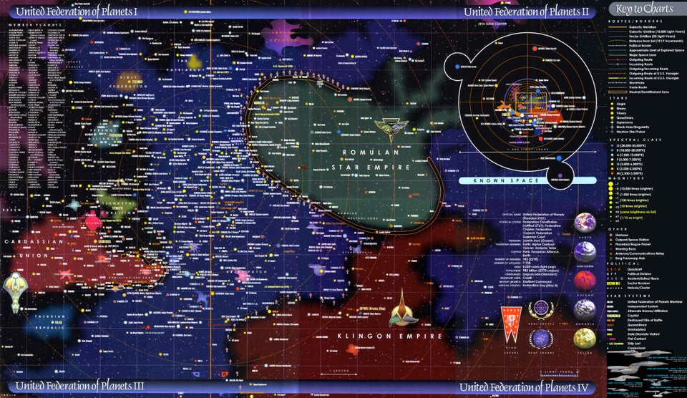
NodeTopologyDefinition.xml
Link: https://goo.gl/TZVDkr (https://perma.cc/T67J-MD54)
Nothing to do here 99.9% of the time
Notes:
http://www.atomicax.com/article/d365ffo-prem-node-and-database-topology

Slide 29
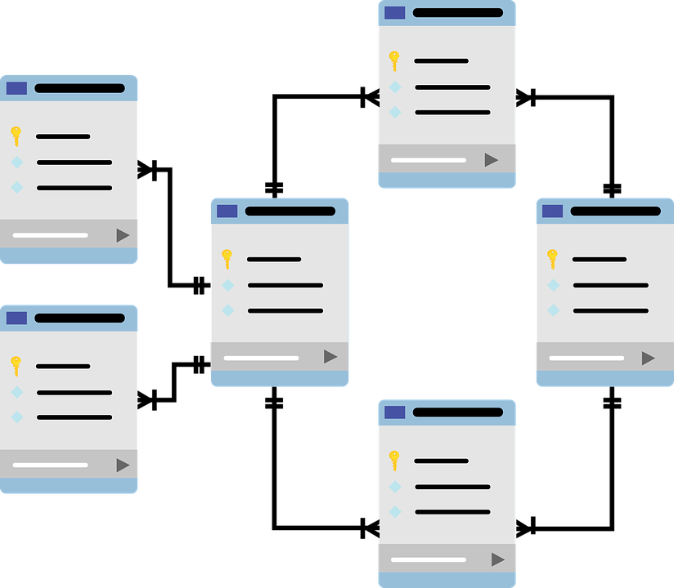
DatabaseTopologyDefintion.xml
Link: https://goo.gl/TZVDkr (https://perma.cc/T67J-MD54)
Username
DbNames – Transactional, Orchestrator, Financial Reporting
Any other DB related changed from ConfigTemplate.xml
Notes:
http://www.atomicax.com/article/d365ffo-prem-node-and-database-topology

Slide 30
Execution – 1 and Done

Slide 31
Configure SQL Server
SQL Must be run as a domain user – create a domain user for the service to run under
Install or generate cert
Typical SQL install profile with full text indexing (No SSIS or SSRS required)
https://docs.microsoft.com/en-us/dynamics365/unified-operations/dev-itpro/deployment/setup-deploy-on-premises-pu12#setupsql
Notes:
https://www.youtube.com/watch?v=aOOyE82kfok
https://docs.microsoft.com/en-us/dynamics365/unified-operations/dev-itpro/deployment/setup-deploy-on-premises-pu12#setupsql

Slide 32
Configure File Share Storage, Part 1
Install using PowerShell:
Install-WindowsFeature -Name FS-FileServer -IncludeAllSubFeature -IncludeManagementTools
Create shares for each named environment
Will apply environment specific security later

Slide 33

Configure AD FS
Easy Mode! Use PowerShell Script.
Link: https://goo.gl/ZAkdZ4 (https://perma.cc/C844-YDEE)
Notes:
http://www.atomicax.com/blog-entry/powershell-install-adfs-d365-ffo-prem
https://docs.microsoft.com/en-us/dynamics365/unified-operations/dev-itpro/deployment/setup-deploy-on-premises-pu12#configureadfs

Slide 34
Execution - Cluster

Slide 35
Certificates (again)
Generate certs
Depending on type selected, make sure it is reflected in the ConfigTemplate.xml
Copy PFX files into VM directories after next step
# Create self-signed certs
.\New-SelfSignedCertificates.ps1 -ConfigurationFilePath .\ConfigTemplate.xml
# Exports Pfx files into a directory VMs\<VMName>, all the certs will be written to infrastructure\Certs folder.
.\Export-PfxFiles.ps1 -ConfigurationFilePath .\ConfigTemplate.xml
Notes:
https://docs.microsoft.com/en-us/dynamics365/unified-operations/dev-itpro/deployment/setup-deploy-on-premises-pu12#configurecert

Slide 36
Configure VMs
Script will generate specific VM scripts; copy to shared workspace; copy back down to each node
Use Planning Spreadsheet to copy certs
Navigate to the VM directory
# Install pre-req software on the VMs.
.\Configure-PreReqs.ps1 -MSIFilePath <path of the MSIs>
# Run if they exist
.\Add-GMSAOnVM.ps1
.\Import-PfxFiles.ps1
.\Set-CertificateAcls.ps1
.\Test-D365FOConfiguration.ps1
Notes:
https://docs.microsoft.com/en-us/dynamics365/unified-operations/dev-itpro/deployment/setup-deploy-on-premises-pu12#setupvms

Slide 37
Create The Cluster
From an ORCH node
.\New-SFClusterConfig.ps1 -ConfigurationFilePath .\ConfigTemplate.xml -TemplateConfig <ServiceFabricStandaloneInstallerPath>\ClusterConfig.X509.MultiMachine.json
.\TestConfiguration.ps1 -ClusterConfigFilePath .\clusterConfig.json
#If test was successful
STOP – review ClusterConfig.json file. Some performance tuning opportunities
.\CreateServiceFabricCluster.ps1 -ClusterConfigFilePath .\ClusterConfig.json
Notes:
https://docs.microsoft.com/en-us/dynamics365/unified-operations/dev-itpro/deployment/setup-deploy-on-premises-pu12#setupsfcluster
Replace share for machine1
Change default install directory for cluster
Version 7.3 deployment issues, KB

Slide 38
Connect To LCS
#Run once and only once
.\Add-CertToServicePrincipal.ps1 -CertificateThumbprint <OnPremLocalAgent Certificate Thumbprint>
Refer to known issues
Notes:
https://docs.microsoft.com/en-us/dynamics365/unified-operations/dev-itpro/deployment/setup-deploy-on-premises-pu12#configurelcs

Slide 39
Configure File Share Storage, Part 2
Create shares
Agent
Aos-storage
DiagnosticsStore (for cluster)
Add specific security for each share
https://docs.microsoft.com/en-us/dynamics365/fin-ops-core/dev-itpro/deployment/setup-deploy-on-premises-pu12#setupfile
Notes:
https://docs.microsoft.com/en-us/dynamics365/unified-operations/dev-itpro/deployment/setup-deploy-on-premises-pu12#setupfile

Slide 40

Encrypt (all other) Credentials
Encrypt the credentials for the AOS service account from a cluster node member
Credentials.json
Invoke-ServiceFabricEncryptText -Text '<textToEncrypt>' -CertThumbprint '<DataEncipherment Thumbprint>' -CertStore -StoreLocation LocalMachine -StoreName My | Set-Clipboard
Notes:
https://docs.microsoft.com/en-us/dynamics365/unified-operations/dev-itpro/deployment/setup-deploy-on-premises-pu12#encryptcred

Slide 41
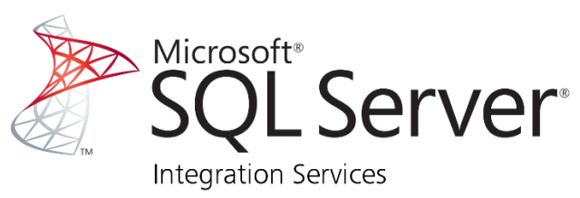
Install SSIS
Install SSIS on AOS node(s)
Licensing a consideration
Notes:
https://docs.microsoft.com/en-us/dynamics365/unified-operations/dev-itpro/deployment/setup-deploy-on-premises-pu12#setupssis
https://www.youtube.com/watch?v=Db4fJ8qTztU

Slide 42
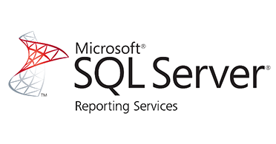
Install and Configure SSRS
Install and configure SSRS on SSRS node
Scale-out not currently supported
Licensing a consideration
Notes:
https://www.youtube.com/watch?v=DvW9rbGBHPE

Slide 43
From ORCH Node, run scripts to configure databases from InfrastructureScripts:
.\Initialize-Database.ps1 -ConfigurationFilePath .\ConfigTemplate.xml -ComponentName Orchestrator
.\Initialize-Database.ps1 -ConfigurationFilePath .\ConfigTemplate.xml -ComponentName AOS
.\Configure-Database.ps1 -ConfigurationFilePath .\ConfigTemplate.xml -ComponentName AOS
.\Initialize-Database.ps1 -ConfigurationFilePath .\ConfigTemplate.xml -ComponentName MR
Notes:
https://docs.microsoft.com/en-us/dynamics365/unified-operations/dev-itpro/deployment/setup-deploy-on-premises-pu12#configured

Slide 44
Configure ADFS – First install
.\Publish-ADFSApplicationGroup.ps1 -HostUrl 'https://ax.d365ffo.onprem.contoso.com’

Slide 45
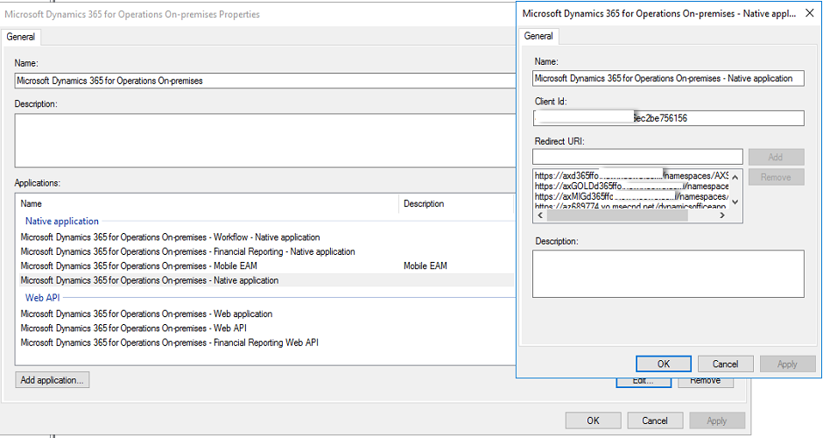
Configure ADFS – not first install
Notes:
Open ADFS manager, find D365FO LBD, add entries in workflow native app, native app and and financial reporting native app

Slide 46
Configure Connector and Local Agent
Add Connector in LCS
Download installer
#Script to get all the values LCS needs
.\Get-AgentConfiguration.ps1 -ConfigurationFilePath .\ConfigTemplate.xml
#command line to install LocalAgent
LocalAgentCLI.exe Install <path of config.json>
Send Message in LCS - wait
Notes:
https://docs.microsoft.com/en-us/dynamics365/unified-operations/dev-itpro/deployment/setup-deploy-on-premises-pu12#configureconnector

Slide 47

Deploy Dynamics 365 F&O LBD
From ADFS Box, run this as user with domain admin using the ConfigTemplate.xml file for the instance you are working with.
#Script to get most values required by LCS
.\Get-DeploymentSettings.ps1 -ConfigurationFilePath .\ConfigTemplate.xml
Notes:
https://docs.microsoft.com/en-us/dynamics365/unified-operations/dev-itpro/deployment/setup-deploy-on-premises-pu12#deploy

Slide 48
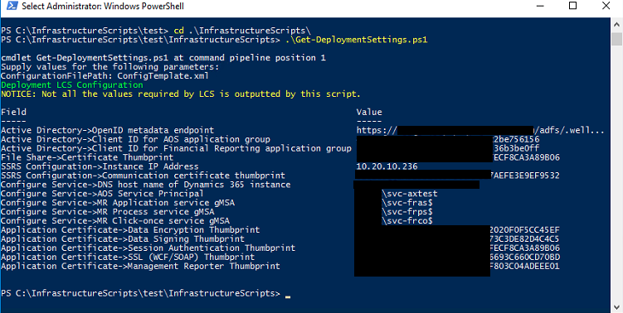
Deploy Dynamics 365 F&O LBD
Notes:
https://docs.microsoft.com/en-us/dynamics365/unified-operations/dev-itpro/deployment/setup-deploy-on-premises-pu12#deploy

Slide 49
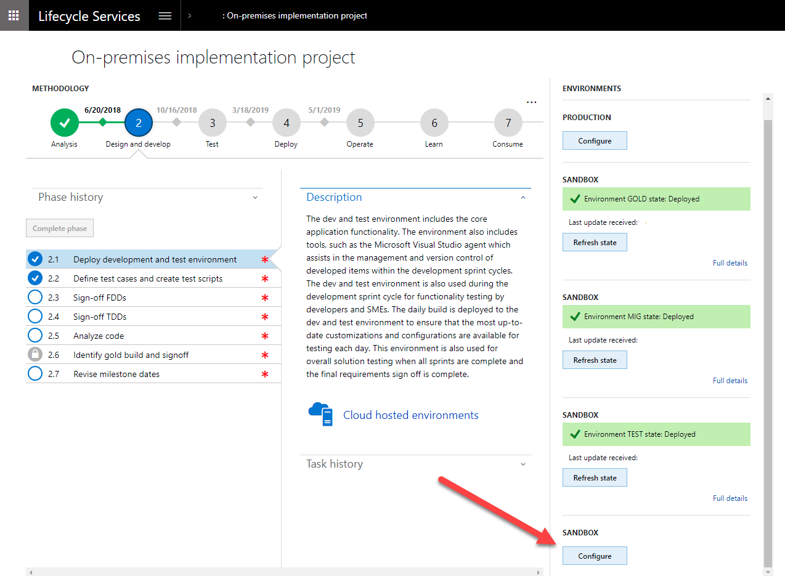

Slide 50

If All Goes Well….

Slide 51
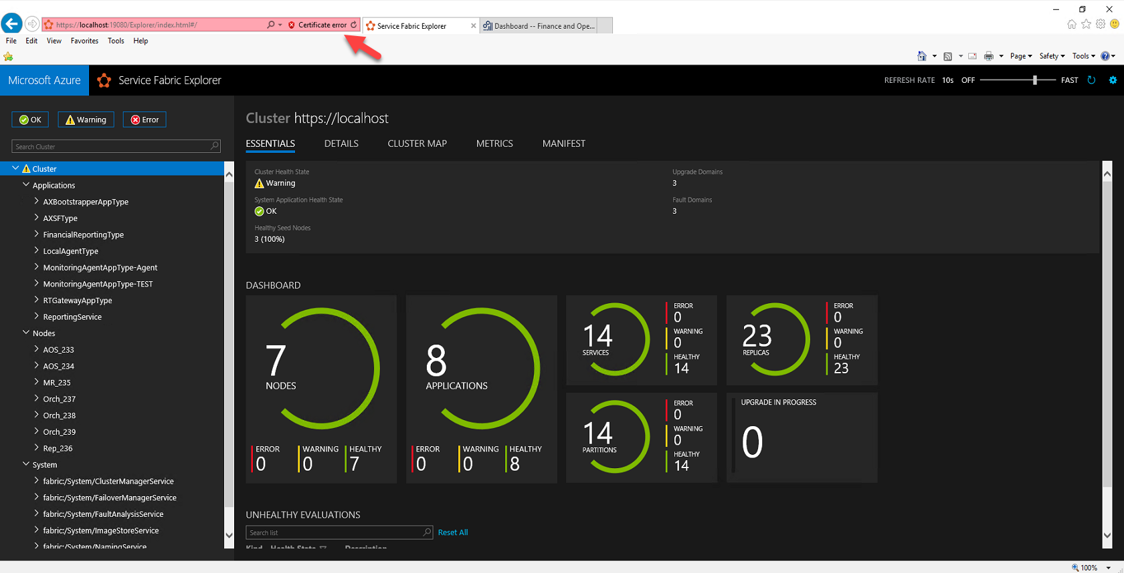
Notes:
Service fabric cluster explorer
Nodes – vms
Apps – 8 by default in complete install
Services – 14 by default tin complete install, same with partitions
Replicas – depends on number of nodes and apps. 23 in a 7 node cluster, 16 in 4 node cluster, 21 in 5 node cluster

Slide 52
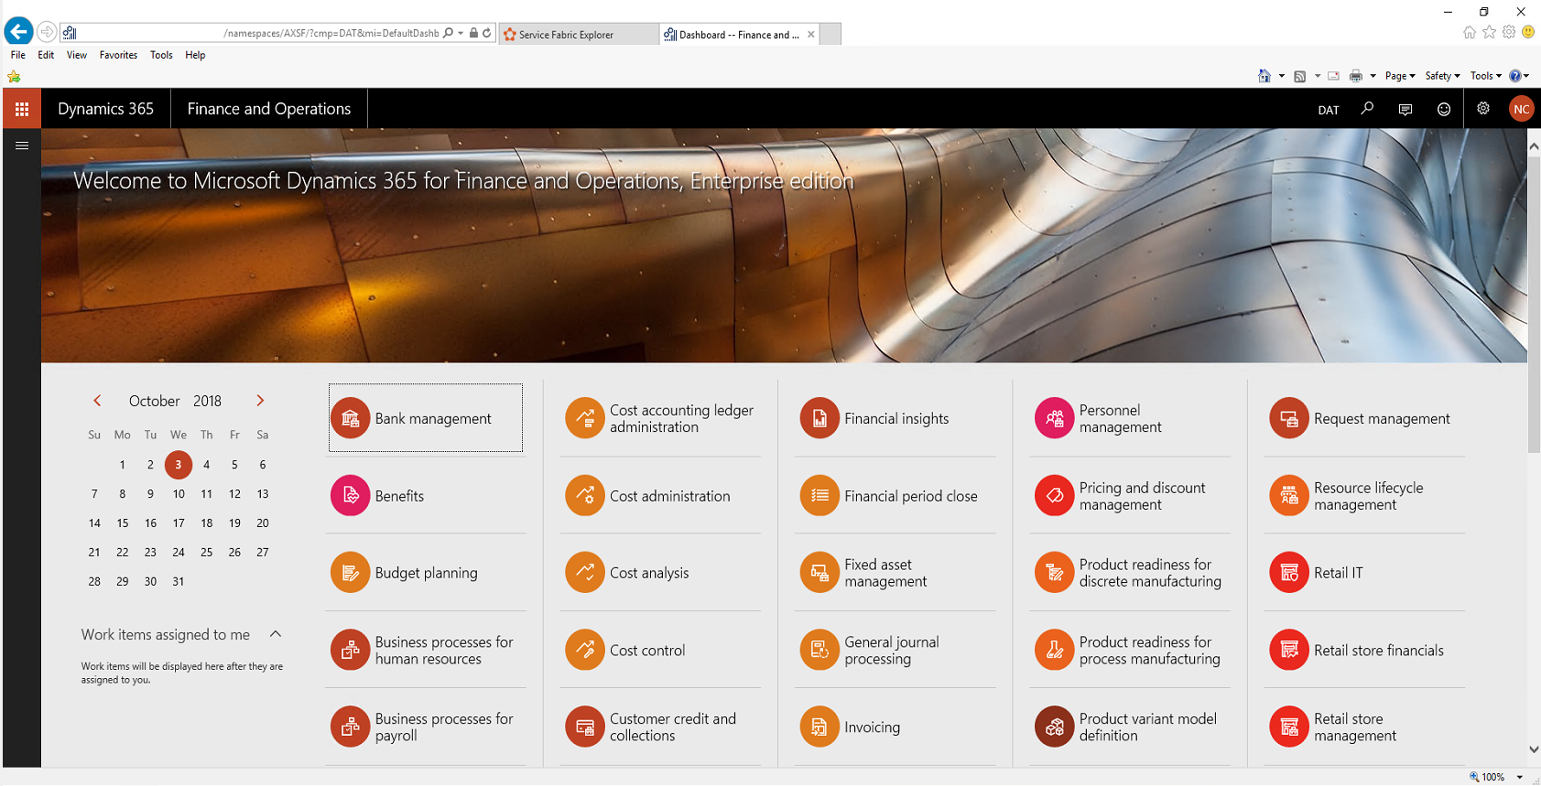

Slide 53

Questions?

Slide 54
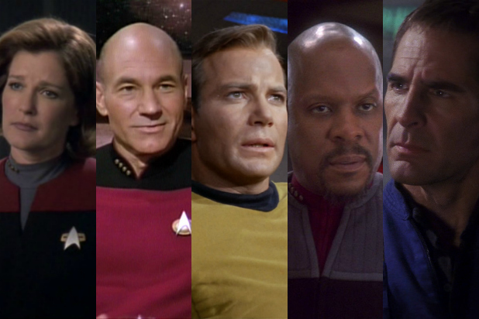
Please Let Us Know Your Feedback
We want to hear what you think even if you think I’m terrible but want to be polite about it.
Image Credits: https://pixabay.com/, https://www.microsoft.com/en-us/, https://twitter.com/

Slide 55
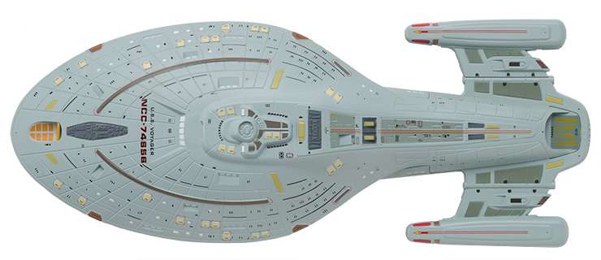
Thank you! Please Complete The Survey!
https://www.linkedin.com/in/nathanclouseax/
https://twitter.com/NathanClouseAX
http://www.atomicax.com/
https://github.com/NathanClouseAX/
Nathan.Clouse@MCAConnect.com
Nathan Clouse
Technical Solution Architect
MCA Connect, LLC
AXUG Summit Track Leader
Nathan.clouse@mcaconnect.com
www.atomicax.com
@NathanClouseAX

